Slide 1
Extreme daily precipitation events at Spitsbergen, an Arctic Island
Mark C. Serreze
Alex D. Crawford
Andrew P. Barret

Slide 2

Overview
Introduction
Location
Data – Observations
General Climate
Event Statistics and Case Studies
Composite Analysis
Conclusion

Slide 3
Introduction
Extratropical cyclone activity in winter
Northern Atlantic is a primary pathway for transport of atmospheric energy into the Arctic
Focusing on extreme daily precipitation events at Ny Ålesund station, located on Spitsbergen, the largest island of Svalbard
Comparison with three other stations at Spitsbergen
Motivated by growing interest in extreme precipitation events

Slide 4
Location

Slide 5
Data – Stations
Data records from www.eklma.no, operated by MET Norway
Records for Ny Ålesund, Longyearbyen and Sveagruva begins in 1974, 1964 and 1978 and runs until present (Sveagruva stops at 2003). Barentsburg station starts in 1932 (operated by Russia), data gathered from NOAA NCDC.
Periode 1979 – 2014 (except Sveagruva)

Slide 6
Data - models
2/3 degrees logitude, ½ degree latitude at 72 levels.
1 hour interval data is used to derive 12 hour accumulated precipitation output from MERRA (Modern-Era Retrospective Analysis for Research and Applications)
MERRA data shows localized maxima corresponding to areas of pronounced topography.
Precipitation for station locations are much lower than grid cells at higher elevations.

Slide 7
General Climate and event size statistics
Unusual warm climate due to the Nort Atlantic Drift Current
Mean temperature between -12,4 in february and 5,3 in July.
Despite frequent cyclone activity, only 423 mm annual precipitation at Ny Ålesund. Longyearbyen: 195 mm
Spring to early summer minimum

Slide 8
event Statistics, Ny Ålesund
A-Ny Ålesund. B-Barentsburg. C=Longyearbyen. D-Sveagruva
Precipitation events 24% of all days
Median event size: 3mm
Extreme event: top 1%
NÅ(31mm), Bar(22mm), Long(15mm), Sve(18mm)

Slide 9
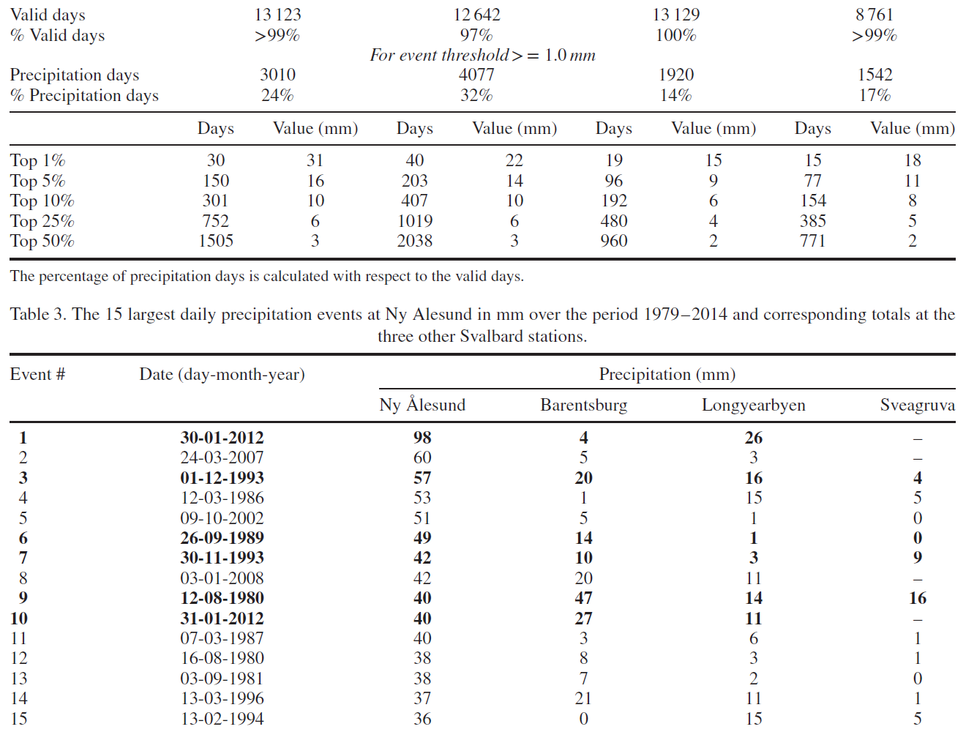
Large local differences

Slide 10
Case 30-31 January 2012
98 mm record event followed by 40 mm event nex day (10th largest)
Unusually warm
Significant increase in permafrost temperatures down to 5m
Damaged infrastructure due to slush-slide
Ground covered in ice – starving reindeer
Annomaly computed by MERRA from 36-year average (1979-2014)

Slide 15
Atmospheric River?
Strong positive annomalie in the northern end of a narrow band from the subtropics
«Zhu and Newell (1998) showed that in excess of 90% of the total meridional water vapour transport in the mid-latitudes occurs through such atmospheric rivers. »
Event caused by synoptic-scale uplift in combination with AM from the subtropical Atlantic

Slide 16
Case 26-28 September 1989
49mm in NÅ and 14mm at Barentsburg on sept. 26th and 28mm/33mm on the 27th/28th at Barentsburg
Not same AM features. More synoptic complex.

Slide 21
Composite analysis NÅ (all seasons)
How is the average atmospheric conditions accosiated with precipitation extremes?
Entire region has positive annomaies in precipitable water
MERRA only suitable for providing qualitative depictions of broad scale patterns
MERRA failes to capture highly localized aspects on Spitsbergen due to topography

Slide 23
Temporal trends
General
Strong winter warming over Svalbard in recent decades
Increasing total amounts of precipitation (some statistically signnificant, some are not) as well as increasing frequency of extremes – Concistent with increased winter cyclone intensity over the latter half of the 20th century in the northern Atlantic
At Spitsbergen
Only 8 of 96 tests revealed significant trends for the extreme events at NÅ
3 show declinig frequency of extreme events in spring
4 show increased frequency and total precip amout in winter
For both frequency and intensity, no trend was significant for all stations
These are low numbers, might even be random

Slide 24
Discussion and Conclusion
Despite frequent cyclone activity, very modest precipitation extreme at Svalbard
Svalbard is located at the northern end of the atlantic cyclone track → AR rarely reaches the island
Southerly flow occuring during positive pressure height annoalies over Scandinavia and the Barents Sea, and negaative annomalies over Greenland
Local topography is VERY important (extreme events at NÅ often not recorded at the other stations)
No compelling eveindece of temporal trends in extreme precipitation at Spitsbergen
Understanding AR may be key to understand furure Arctic extreme events ?

Slide 25
References
Extreme daily precipitation events at Spitsbergen, an Arctic Island Serreze, Mark C., Crawford, Alex D., Barret, Andrew P. International Journal of Climatology 2015

